Slide 1
Write a program to implement Linear Regression with Multiple Variables.
Exp 03

Slide 2
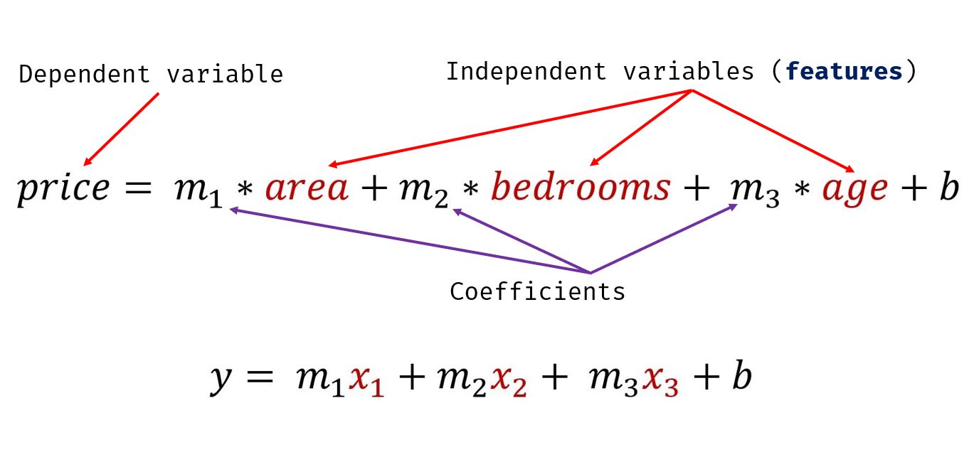
Multiple variables

Slide 3
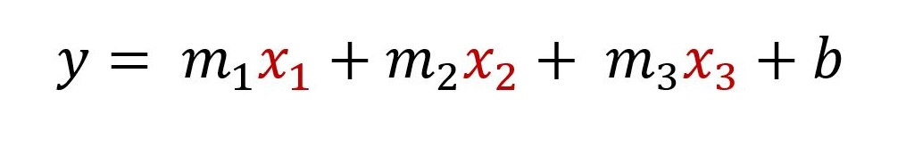

Slide 4
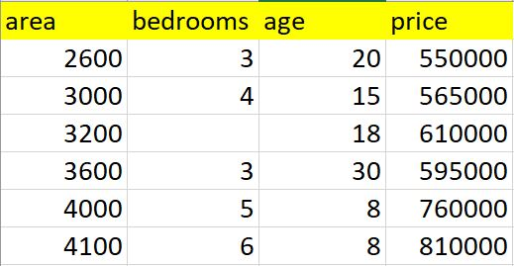
s

Slide 5
Exercise
In exercise folder there is hiring.csv. This file contains hiring statics for a firm such as experience of candidate, his written test score and personal interview score. Based on these 3 factors, HR will decide the salary. Given this data, you need to build a machine learning model for HR department that can help them decide salaries for future candidates. Using this predict salaries for following candidates,
2 yr experience, 9 test score, 6 interview score
12 yr experience, 10 test score, 10 interview score

